Slide 1
SMART-IE Behavioral Pilot Data
Allen Chen

Slide 2
Experiment Set-up
Initial titration phase and testing done on the same day.
11 Points Tested. (0, 10%, 20%, 30%, …, 100%)
50 repetitions of each stimulus
Total experiment time with no EEG: 2 and a half hours to 3 hours
We’re currently struggling with an auditory glitch that caused auditory to be distorted ~halfway through an experiment for two of the five data sets. These data sets had the affected portion of the experiment discarded.

Slide 3
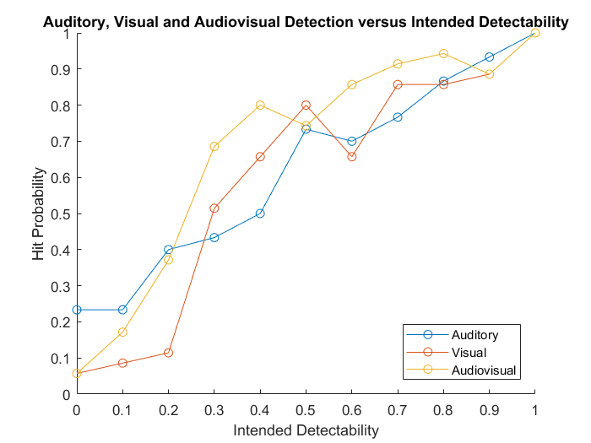
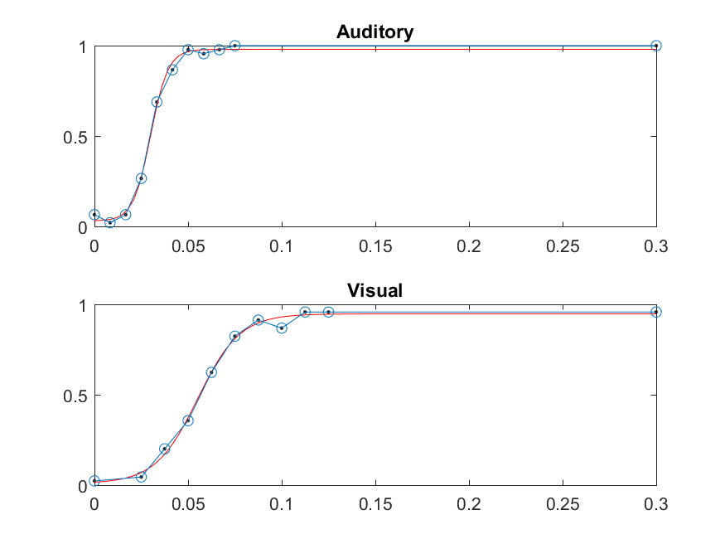
Subject 1
Auditory Glitch
Salvaged Data:
30 reps of each auditory stimulus
25 reps of each visual stimulus
35 reps of each audiovisual stimulus
Notes:
10108007

Slide 4
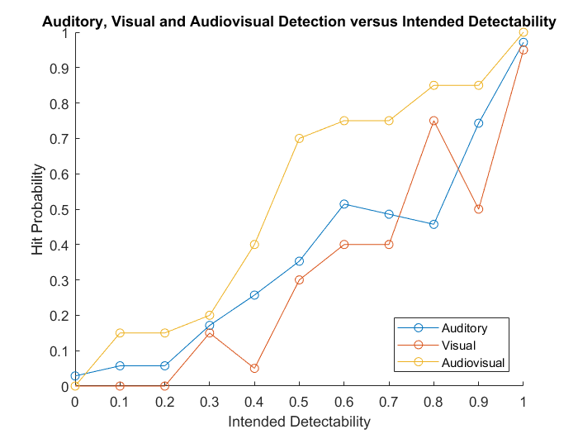
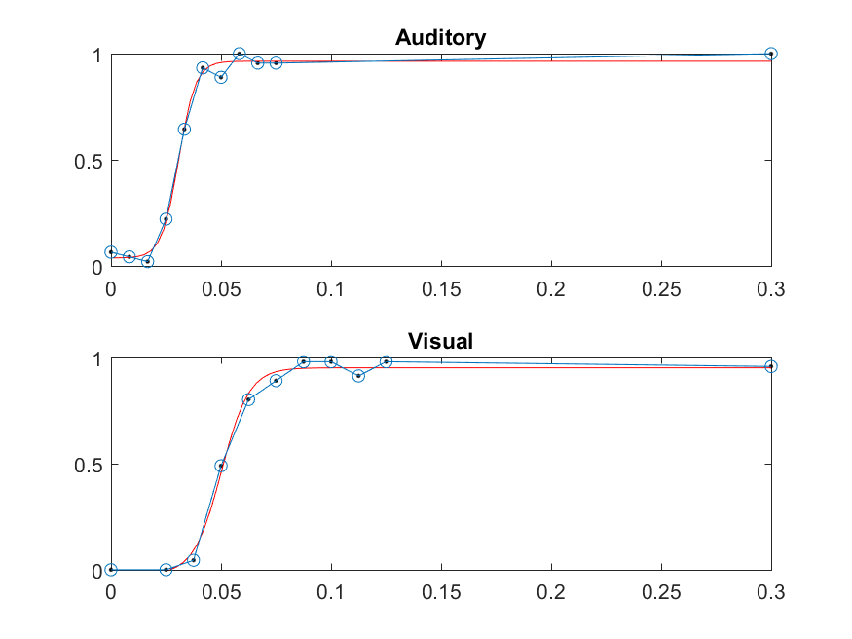
Subject 2
Auditory Glitch
Salvaged Data:
30 reps of each auditory stimulus
20 reps of each visual stimulus
20 reps of each audiovisual stimulus
Notes:
10108008

Slide 5
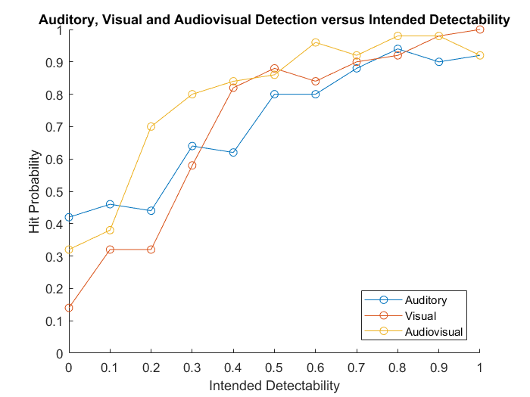
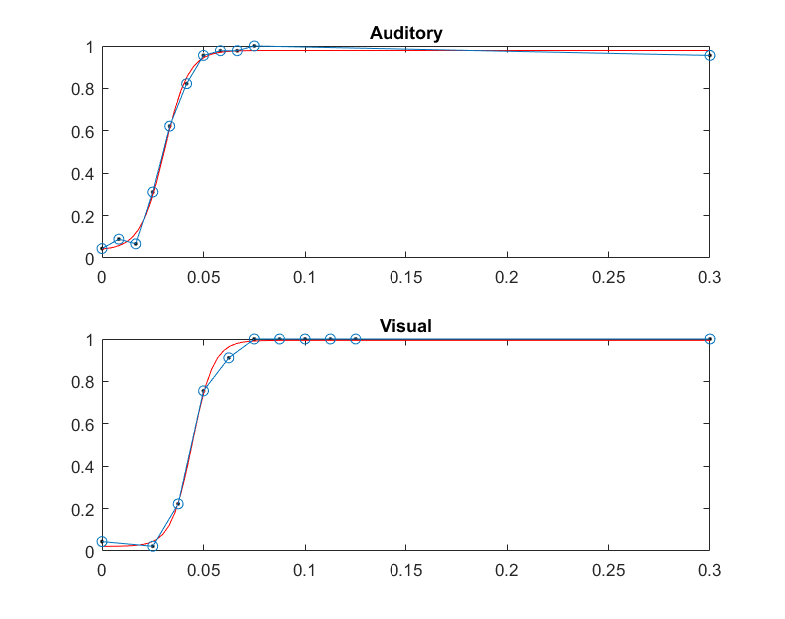
Subject 3
No Auditory Glitch
50 reps of each stimulus
Notes:
10108006

Slide 6
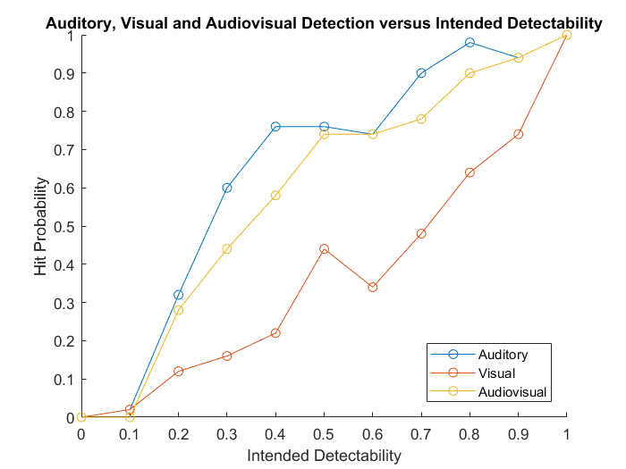
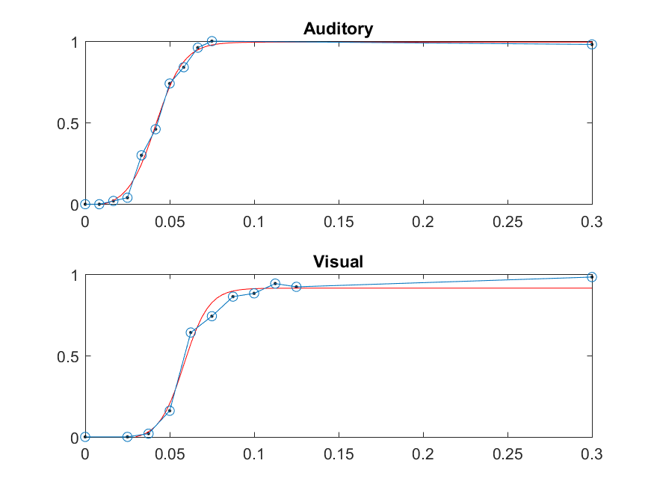
Subject 4
No Auditory Glitch
50 reps of each stimulus
Notes:
10108004

Slide 7
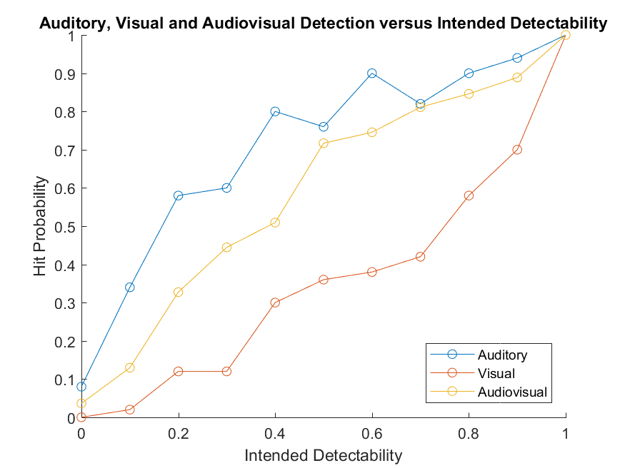
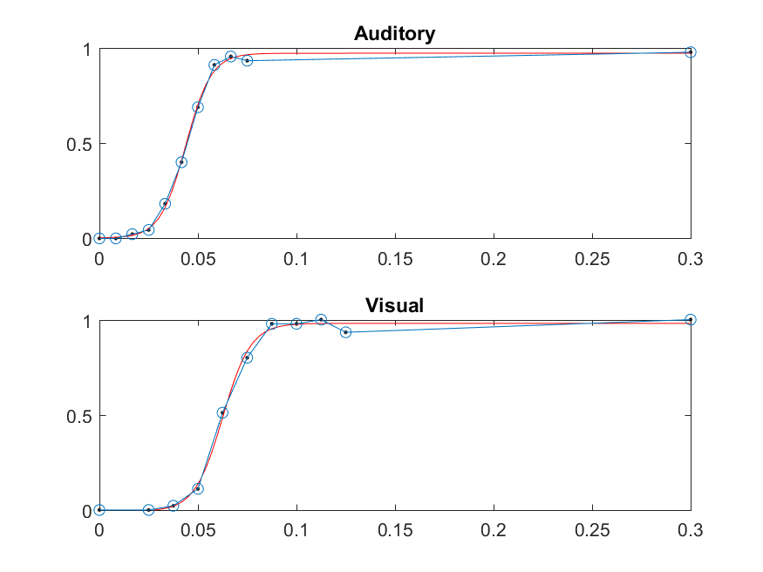
Subject 5
No Auditory Glitch
50 reps of each stimulus
Notes:
10108009

Slide 8
Summary
2/5 participants showed decrease in visual performance during the second part of the experiment. This is associated of an audiovisual curve that is lower than the auditory curve? Perhaps these individuals normally bias to their visual system in an audiovisual block, and then their visual performance decreases, dragging down performance in the audiovisual block.
Next two slides? Why are these participants performing so poorly in the visual task?
To investigate this, I plotted hit rate (meaned across all stimuli types) for each block.
Notes:
10108009

Slide 9
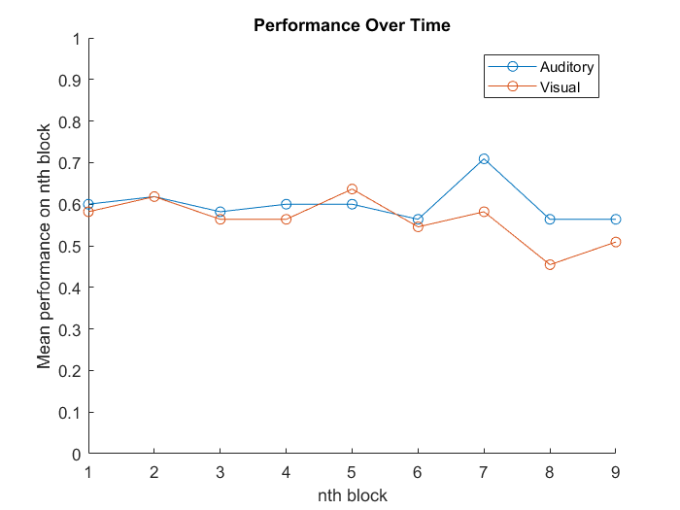
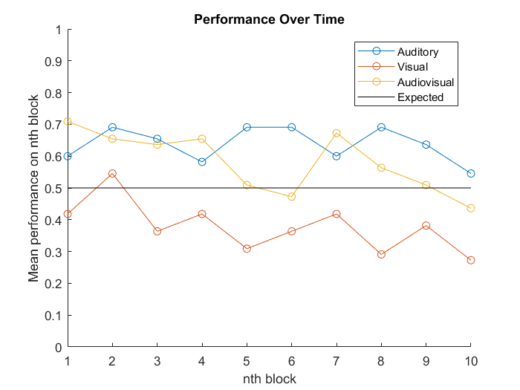
Subject 4 - Unclear
Titration Phase
Second Phase
Each block has 55 stimuli, 5 of each intensity value
Mean performance on nth block is the hit rate across all of the intensities binned together
Notes:
10108004

Slide 10
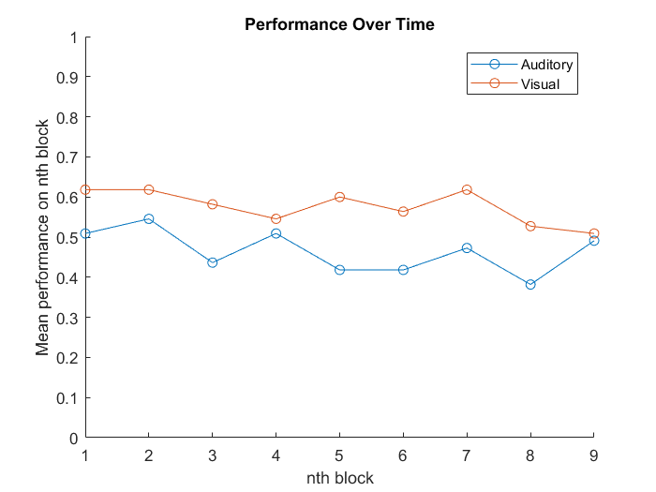
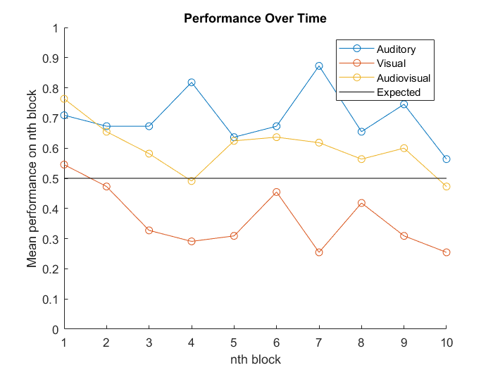
Subject 5 – might be due to fatigue
Titration Phase
Second Phase
Each block has 55 stimuli, 5 of each intensity value
Mean performance on nth block is the hit rate across all of the intensities binned together
Notes:
10108009

Slide 11
Summary
After plotting subject 4 and 5’s behavior over time, it seems like there is a sudden visual performance drop between the end of the initial phase and the beginning of the second phase for subject 4. This is not explained by a decrease in performance over time in the titration phase. For subject 5, there is a quick fall of visual performance between the first and fourth visual blocks in phase II. Subject 5’s bad visual performance may be due to fatigue.
Other Possible Reasons:
Context change going from titration phase to second phase. We use very similar stimuli, but it’s not perfectly matched. For example, the titration phase has more points on the asymptotes of the psych curve while the second phase has more points along the steep part of the curve.
Notes:
10108009

